Slide 1
May 2020 NYC Citibike Data
Tania Ommer

Slide 2
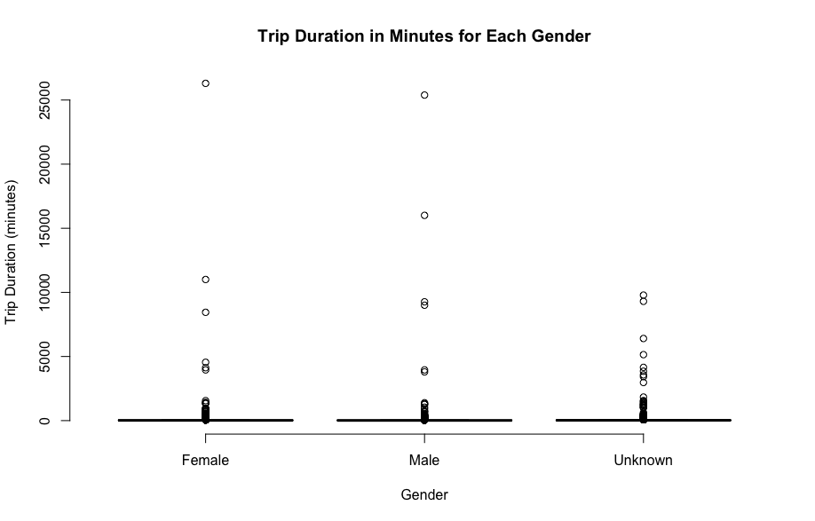
Box Plot
The box plot on the right illustrates Citibike users’ trip durations on the basis of gender
Based on the data, Citibike users were divided into the following gender groups: Unknown(0), Male(1), Female(2)
Due to the large quantity of data (about 50K trips) the plot is difficult to interpret
Difficult to find measure of center and quartiles
There are several outliers in the data set, making it difficult to identify trends

Slide 3
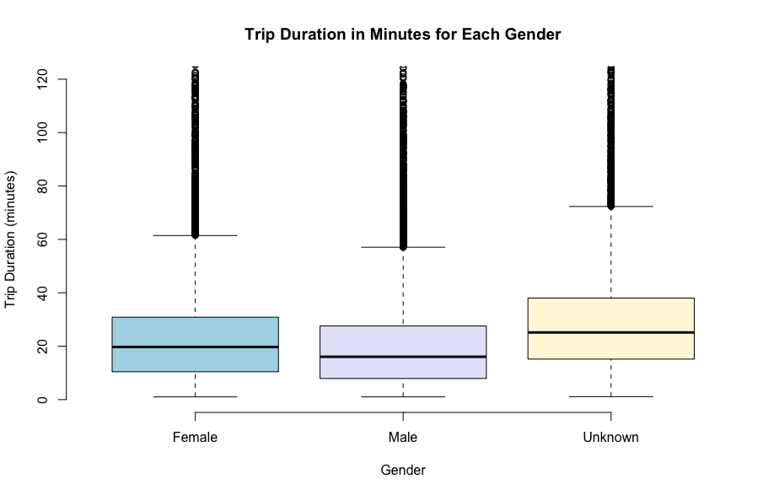
Box Plot (continued)
The box plot to the left does a better job of illustrating the center of the data, making it easier to identify patterns.
The plot limits plotting trip duration (y-axis) past 120 minutes
The mean trip duration for each gender are approximately 20 minutes for females, 16 minutes for males, and 24 for unknown
The graph still shows some outliers for the data, but only until the upper limit of 120 minutes

Slide 4
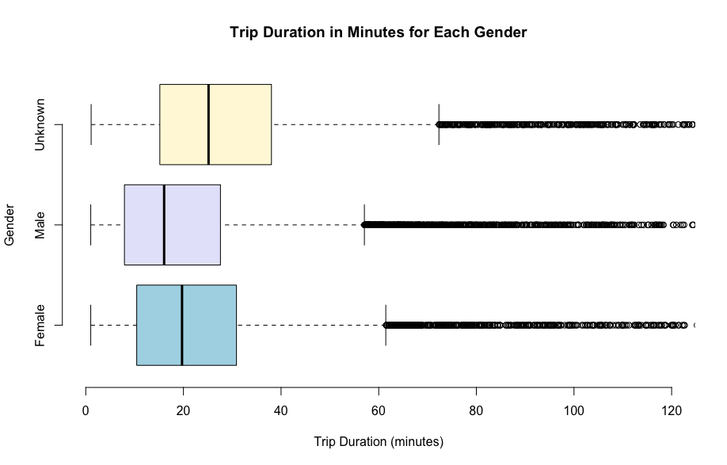
Horizontal Box Plot (continued)
This horizontal box plot shows the same data as the last slide, limiting the trip duration to 120 minutes
The only difference is the orientation of the overall graph
The gender category “Unknown” has the highest trip duration within the box plot
before taking into account all outliers that lie outside of the boxes

Slide 5
Box Plot Insights
These box plots illustrates the differences between trip durations for each gender of Citibike users
Out of the three gender categories: Unknown(0), Male(1), Female(2), males have the lowest mean trip duration while those who did not provide a gender (Unknown) have the highest mean trip duration
Citibike could market more towards men to try and increase the usage and trip duration data of males overall
Citibike could create more accepting and universal branding that promotes both genders and those who prefer not the identify with one
This would help to greatly increase the trip duration data for those who identified in the unknown category

Slide 6
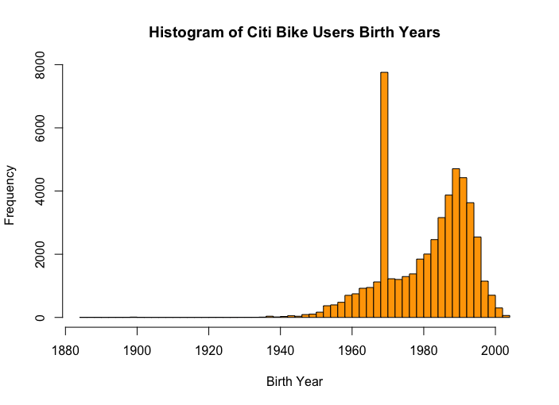
Histogram
This histogram on the right graphs the frequency of Citibike users by their birth years
The highest peak is between the birth years of 1968 and 1970
These Citibike users are currently between 50 to 52 years old
The breaks in the histogram illustrate the spread of ages throughout the data in a easy and readable way

Slide 7
Histogram Insights
The histogram shows the frequency distribution of Citibike users based off their birth years
Citibike could use this plot to target certain age groups with advertising in order to boost their business and trip duration data
Advertising could be emphasized to those who are born around the 1970s and later
Middle aged and younger individuals use Citibike at a higher frequency
To increase Citibike usage among older individuals, such as those born around 1940 and 1950, they could advertise more accessible and easy to use bikes
Methods that would make it safe and easy for older people to use Citibike’s products

